Slide 1
JAVA Unittest Exercise
Ha Chi Oai
COH

Slide 2
AGENDA
Introduction
Context
JUnit
FEST
JaCoCo

Slide 3
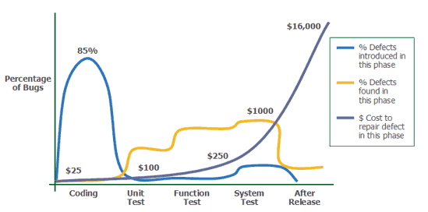
Introduction
Why unit-test?
A lot of discussions about this
But it is a fact that the later defects are detected, the more expensive it is to fix them and more stressful for engineers

Slide 4
Context
You will be given an exercise that contains a simple service (ProjectServiceImpl.java) and a test class (ProjectServiceImplTest.java) use to test the service.
The aim of the exercise is let you to practice how to write a very basic unit test within Eclipse in a proper way and efficient.
Tasks:
Task – 1: Add necessary configuration to make ProjectServiceImplTest.java runnable under Junit (refer slides JUNIT)
Task – 2: Fill MISSING points to verify the test result by using assertion library (refer slides FEST)
Task – 3: Install jacoco, run test and find missing tests cases for the function projectService.findByQuery based on jacoco report result

Slide 5
JUnit
JUnit is a simple framework to write repeatable tests (http://junit.org/)
Download & Install with Maven:
https://github.com/junit-team/junit/wiki/Download-and-Install
Getting Started: https://github.com/junit-team/junit/wiki/Getting-started

Slide 6
FEST
Introduction
https://github.com/alexruiz/fest-assert-2.x/wiki
Install and guild line:
https://github.com/alexruiz/fest-assert-2.x/wiki/One-minute-starting-guide

Slide 7
Code coverage in short
Line coverage: a line of code is covered if it has been run over at least once
Branch coverage (or decision coverage): each control structure (such as an if statement) evaluated both to true and false.
Condition coverage: each boolean sub-expression evaluated both to true and false
JaCoCo supports line coverage, both branch coverage and condition coverage (generally called branch coverage)
There are other types of code coverage such as function coverage, path coverage… But they are not currently supported by JaCoCo.

Slide 8
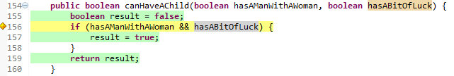

Code coverage in short
Branch coverage in JaCoCo
That is the result of calling
canHaveAChild(true, true)
An still the same (not covered) if calling
canHaveAChild(true, true) canHaveAChild(false, true)
And still the same if calling
canHaveAChild(true, true) canHaveAChild(false, false)
Why the line is still considered as not covered?
Notes:
The reason is: For most Boolean expressions, the Java compiler generates extra branches in the byte code. JaCoCo produces "branch coverage" based on the generated byte code, not based on the original Java code, and hence shows additional branch coverage information for almost any Boolean expression you would use. See a visualization of the generated byte-code in the accompanied slides.

Slide 9
Jacoco
Introduction
http://eclemma.org/jacoco/trunk/doc/mission.html
Installation (Eclipse plugin):
http://eclemma.org/installation.html#updatesite

Slide 10
COH
coh@elca.vn

